Slide 1

Westwood-Crestview
Community Forum
Councillor Evan Duncan
Inspector M Waddell
October 1st 2025

Slide 2
City of Winnipeg
2025 projected population of Winnipeg approx. 854,100
(Grown 20% over past ten years)
237 Neighborhoods
15 Councillor Wards
Diverse Community

Slide 3
Winnipeg Police Service
Governance by Winnipeg Police Board (2013)
Executive : Chief Gene Bowers, D/C S Halley, Supt B Miln
Transparency/Accountability/Service Delivery
Current Complement: Authorized Police members 1425
1974 Amalgamated 13 Police Depts to WPG Department
2013 Four District Model – Deploys a min 28 (2) mem cars
Supported by numerous specialized units

Slide 4
Telecommunications 2024
There were over 770,000 calls to Communications Center
Average of over 2000 calls per day
Represents a 12.6% increase over the five year average
Non dispatched events increased for the fourth year in a row, also reaching a historic high

Slide 5
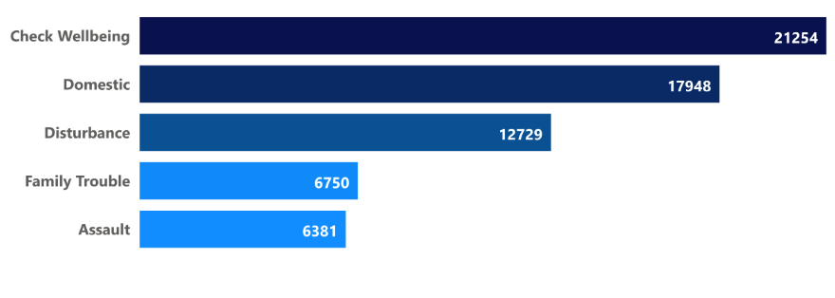
Top 5 Citizen Generated Events

Slide 6
West District Station
2321 Grant Ave
Geographically Covers approx. 46% of the entire City
Equates to approx. 220 sq./km
6 Councillor Wards
Inspector, Staff Sergeant, Admin Sergeant and Clerk

Slide 8
1201 AREA Borders: North: Notre Dame Ave South: Portage Ave + Tylehurst St, Richmond St. West: (South to North) St.James St./Strathcona St./Valour St. East: Ingersoll St.
1202 Area Borders: North: Railway north of Omand’s Creek Blvd. South: Assiniboine River West: (South to North) Conway St/Braintree Cr/Wallasey St. East: (South to North) St.James St./Strathcona St./Valour St.
1203 Area Borders: North: Notre Dame Ave/Four Mile Rd South: Assiniboine River West : Camp Manitou Rd/ Fesitval Dr. East: (South to North) Conway St/Braintree Cr/Wallasey St.

Slide 9
1204 Area Borders: North: Assiniboine River South: Red River (Along Churchill Dr) West: Stafford St / Railway East of Pembina Hwy) East: Red River
1205 Area Borders: North: Assiniboine River South: Bishop Grandin Blvd West: (South to North) Waverley St/Renfrew St East: Red River
1206 Area Borders: North: Bishop Grandin/Public Rd South: Marchand Rd West: Brady Rd East: Red River
1207 Area Borders: North: Assiniboine River South: Wyper Rd/Public Rd West: Perimeter Hwy East: (South to North) Waverley St/Renfrew St

Slide 10
West District Complement
166 members (143 Cst’s)
4 School Resource Officers
6 platoons (20) working A/B Side 24 hr – 365 days
7 (2 member cruiser cars) – 2 Street Supervisors
10 hour shifts
Primary Mandate – Calls for Service
Secondary Mandate - Proactive Initiatives
Investigations - Criminal Investigation Bureau

Slide 11
Notable Results
Sept 3rd – Armed Robbery at Unicity retailer
INCIDENT – C25*207573. WDS CSU – assigned to monitor area and were alerted to four teens shoplifting that resulted in one of the youth firing a co2 propelled firearm at security personnel narrowly missing him. All fourth youth taken into custody recovering stolen property.
Sept 17th – Winnipeg Transit Violent Crime Intervention Incident
INCIDENT # C25*220823/C25*220971
WDS members assigned to Transit Unicity Hub 3600 Block of Portage.
Members were alerted to theft in progress as a male made his way to the bus and was in possession of stolen property.
Members attempting to get on bus when alerted to male who had just smashed window out of the bus breaching release order conditions.

Slide 12
Notable Results
Sept 18th Male wearing Balaclava breaching conditions/stolen property
INCIDENT – C25*219947
LOCATION: Portage Ave/ David Street
Alerted to the a/m situation and determined male was breaching several conditions that prohibit him from entering the City of Winnipeg!
Found in possession of stolen property from 3600 Block of Portage
Sept 18th Suspect used transit bus to flee – numerous charges
C25*221833
LOCATION: 3100 Block of Portage Ave.
Between July 7th and August 24th. Charged with theft under x6, FTC Release order x2 and on two outstanding warrants for FTC with Probation and attend

Slide 13
Take Action
Every member of the community should be on the lookout for a potentially bad situation. We all have a role to play in Safety and Crime prevention. “Take Action”.

Slide 14
How to report a Crime?
Emergency dial 911
Non Emergency dial 986-6222
Report a Crime Online
Winnipeg.ca/police
WDS Community Support
204-986-2839

Slide 15
Questions & Discussion
Thank you!

